Slide 1

Agentic AI, LangChain, & Prompt Engineering

Slide 2
Section 1
Introduction to Agentic AI

Slide 3






What is an AI Agent?
Core Definition
Key Components
Why Agentic?
An AI Agent is an autonomous system that perceives its environment, makes decisions, and takes actions to achieve specific goals.
An agent is powered by an LLM as the "brain," a set of Tools (e.g., search, APIs), and a Planning/Reasoning loop to decide what to do next.
Moves beyond simple Q&A to autonomous problem-solving. Agents can handle complex, multi-step tasks that require intermediate actions and tool use.

Slide 4
The Evolution: From Chatbots to Multi-Agents
2. Agents (Proactive)
Can use tools and plan. Follows a loop: `Goal -> Plan -> Act -> Observe -> Repeat` until the goal is met.
1. Chatbots (Reactive)
3. Multi-Agent (Collaborative)
Respond directly to input. Follows a simple `Input -> LLM -> Output` path. No ability to act on the world.
Multiple specialized agents work together to solve a complex problem, coordinated by an orchestrator.

Slide 5


Foundational Agentic Design Patterns (1/2)
Tool Use
ReAct (Reason + Act)
The most fundamental pattern. The LLM is "augmented" with functions (tools) it can call. This gives the agent abilities beyond its pre-trained knowledge.
The most common agent loop. The LLM iterates through a cycle:
1.
Reason: Generate a "Thought" about what to do.
•
Google Search
2.
Act: Choose a "Tool" to use and the input for it.
•
Database Queries
3.
Observe: Receive the output from the tool.
•
Code Execution (Python REPL)
This loop repeats until the final answer is found.
•
Any API (GitHub, Jira, etc.)

Slide 6


Advanced Agentic Design Patterns (2/2)
Reflection / Self-Correction
Plan-and-Execute
The agent critiques and refines its own work. This is a powerful pattern for improving the quality of complex outputs like code or reports.
The agent first creates a detailed, multi-step plan to achieve a goal. Then, it executes each step of the plan sequentially.
Example Flow:
1. Agent writes code.
2. Agent runs a "test_code" tool.
3. Agent observes the error.
4. Agent reflects on the error and debugs the code.
This is useful for complex, long-running tasks where a simple ReAct loop might get lost or fail. An "Orchestrator" agent might create the plan and "Worker" agents execute the steps.

Slide 7



Key Pattern: Multi-Agent Systems
Hierarchical
Collaborative (Debate)
Sequential
A "Manager" agent decomposes a goal and delegates sub-tasks to specialized "Worker" agents (e.g., a "Researcher" and a "Writer").
Multiple agents "debate" a problem from different perspectives (e.g., "Coder" and "Tester") to arrive at a robust, validated solution.
Agents operate in an assembly line. One agent's output (e.g., a rough draft) is passed to the next agent (e.g., an "Editor") for refinement.

Slide 8

Role of Orchestration: LangChain vs. LangGraph
LangChain (LCEL)
Provides the core components (LLMs, Tools, Prompts). The LangChain Expression Language (LCEL) is for building stateless pipelines, or "chains."
Think of it as a Directed Acyclic Graph (DAG). It's powerful for linear, predictable workflows (like RAG).
LangGraph
An extension of LangChain for stateful, cyclical computation. It builds agents as graphs (state machines).
This is essential for agentic loops, reflection, and multi-agent systems where state must be updated and passed between nodes.

Slide 9
Section 2
LangChain Fundamentals

Slide 10








Core LangChain Components
Models
Tools
Prompts
Memory
The interface to LLMs, Chat Models, and Embedding Models (e.g., `ChatOpenAI`, `Ollama`).
Functions agents can call. A `Tool` is a single function; a `Toolkit` is a set of tools (e.g., GitHub toolkit).
`PromptTemplates` and `ChatPromptTemplates` to format and parameterize input for the model.
Enables chains/agents to remember previous interactions (e.g., `ConversationBufferMemory`).

Slide 11


Conceptual Difference: Agents vs. Chains
Chains (using LCEL)
Agents (using LangGraph)
Deterministic & Stateless.
Non-Deterministic & Stateful.
Chains follow a pre-defined path (DAG). The developer decides the exact sequence of logic.
The LLM decides the path at runtime based on the input and intermediate results. It operates in a loop.
•
Use Case: Retrieval-Augmented Generation (RAG), summarization, simple tool use, prompt formatting.
•
Use Case: Autonomous research, coding assistants, complex problem solving, multi-agent systems.

Slide 12

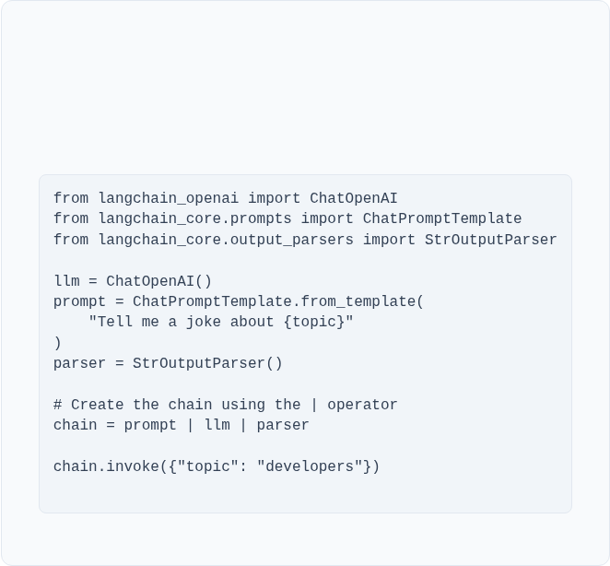
Setting Up Your LangChain Environment
1. Install Libraries
3. Simple Chain (LCEL)
Install the core libraries for LangChain, the OpenAI integration, and LangGraph.
This example shows the LangChain Expression Language (LCEL) "pipe" syntax.
pip install langchain langchain-openai langgraph
2. Set API Keys
Set as environment variables. LangSmith is highly recommended for debugging agents.
OPENAI_API_KEY="sk-..."
LANGSMITH_API_KEY="..."

Slide 13
Section 3
Prompt Engineering Essentials

Slide 14


Templates & Context Management
Prompt Templates
Context Management
Reusable, parameterized prompts. This is the first step in prompt engineering.
LLMs have a limited "context window" (the number of tokens they can remember).
•
Why: Provides consistency, safety, and separates your application logic from the prompt instructions.
•
Chat History: For conversations, use Memory components to automatically manage and pass history.
•
Example:
You are a helpful {role}. Answer the user's question: {question}
•
Large Docs: For large documents, use RAG. You retrieve only the most relevant chunks and "stuff" them into the prompt.

Slide 15
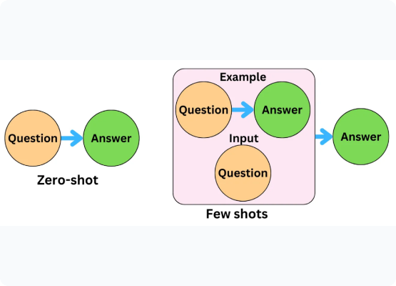
Few-Shot Prompting
Zero-Shot
Relying on the LLM's pre-trained knowledge to follow an instruction.
Prompt: "Classify: 'This is great!' ->"
Few-Shot
Providing 2-5 examples in the prompt to guide the LLM's output format and reasoning. This is extremely effective for complex or specific formatting tasks.
Prompt:
"Classify: 'I hate this' -> Negative"
"Classify: 'This is amazing!' -> Positive"
"Classify: 'It was okay.' -> Neutral"
"Classify: 'This is great!' ->"
(LLM will reliably answer `Positive`)

Slide 16
Parameter Tuning for Developers
Parameter | What it Does | Use Case for Developers
Temperature | Controls randomness/creativity. (0.0 = deterministic, 1.0+ = creative) | Use low (0.0-0.2) for factual answers, classification, or code generation. Use high (0.7+) for creative writing or brainstorming.
Max Tokens | The maximum number of tokens to generate in the output. | Controls cost and prevents runaway/incomplete outputs. Keep it as low as you reasonably need.
Chain Type (RAG) | How context is "stuffed" into the prompt. (`stuff`, `map_reduce`, `refine`) | Use `stuff` (fastest) if all docs fit in the context. Use `map_reduce` (slower, more calls) if you have too many docs to fit.
Stop Sequences | A string that, when generated, forces the model to stop. | Useful for forcing formatted output. E.g., if you ask for JSON, you can set the stop sequence to `}`.

Slide 17
Questions?

